Slide 1
Object Oriented Analysis and Design
Introduction

Slide 2
System/Software Life Cycle (SLC)
Life cycle is the series of steps that software undergoes from concept exploration through retirement.
Intended to develop information systems in a very thoughtful, structured and methodical way, reiterating each stage of the life cycle.
Maturity of the process is some gauge of success of organization.

Slide 3
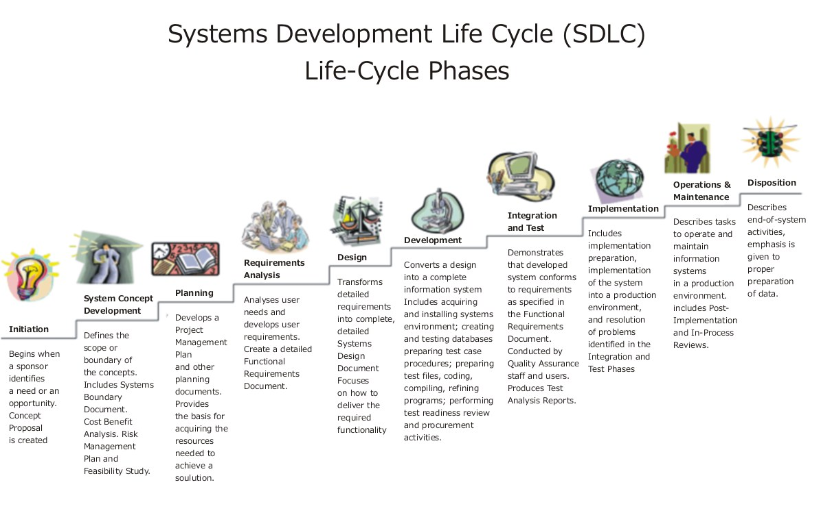
Source: http://upload.wikimedia.org/wikipedia/commons/b/bb/Systems_Development_Life_Cycle.jpg

Slide 4
Importance of Lifecycle Models
Provide guidance for project management
what major tasks should be tackled next? milestones!
what kind of progress has been made?
The necessity of lifecycle models
characteristics of software development has changed
early days: programmers were the primary users
modest designs; potential of software unknown
more complex systems attempted
more features, more sophistication → greater complexity, more chances for error
heterogeneous users

Slide 5
Build and Fix Model

Slide 6
Waterfall Model
Requirements
Phase
Requirements
Description
Specification
Phase
Specification,
SPMP
Design
Phase
Design Docs
Verify
output of stages
Verify
output of stages
Implementation
& Integration
Phase
Flaw?
Product
original model didn’t
let you go back!
Operations
Mode
Retirement
Notes:
The major flaw with the original model is that it didn’t support iteration…
what if there was an incompleteness, contradiction, or ambiguity in the specification?

Slide 7
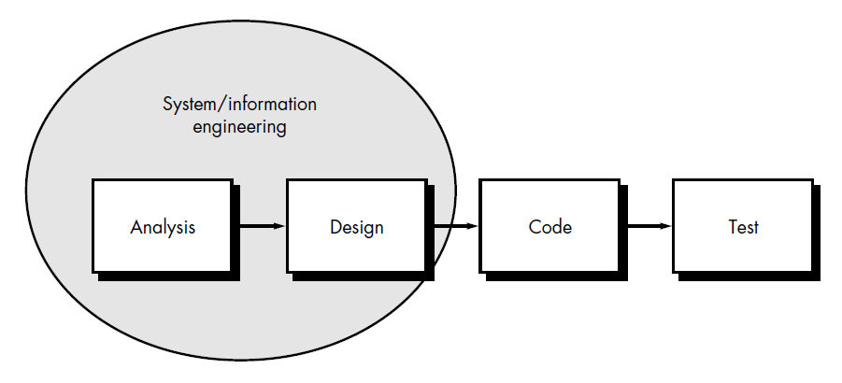
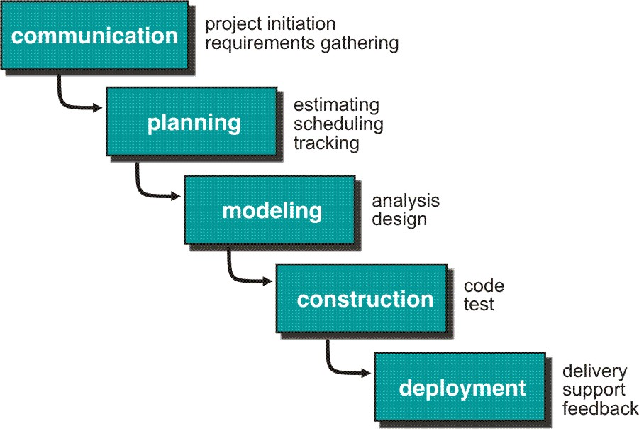

Slide 8
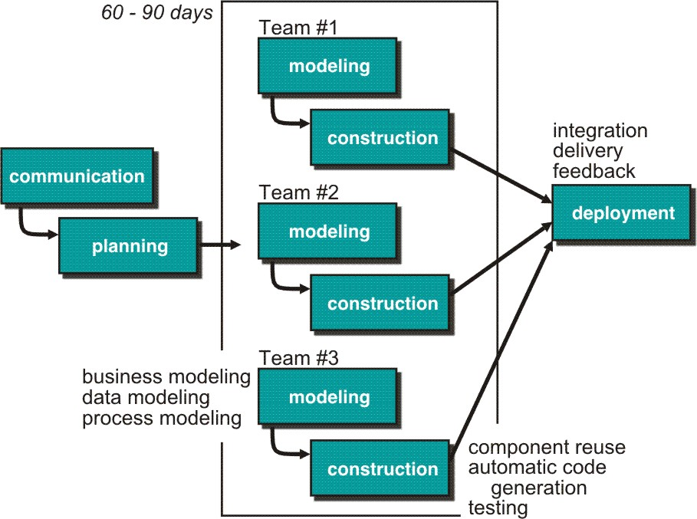
Rapid Application Development (RAD) Model
Makes heavy use of reusable software components with an extremely short development cycle

Slide 9
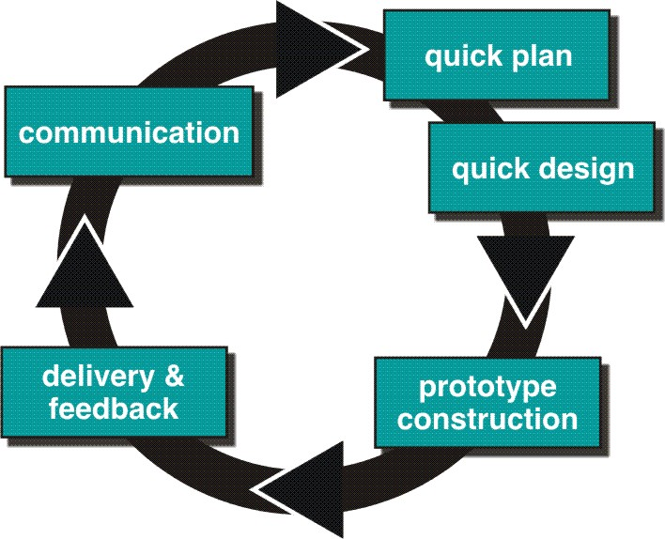
Prototype Model

Slide 10
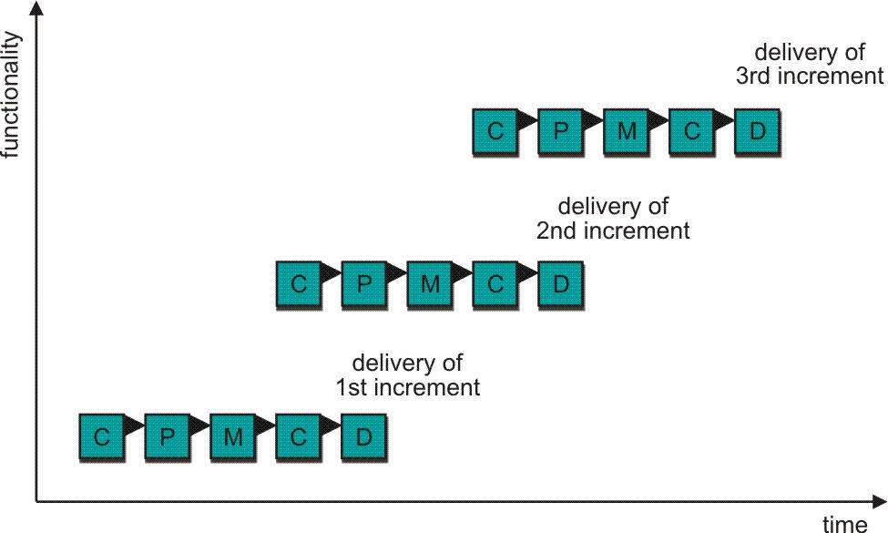
Incremental Model
C- Communication
P - Planning
M – Modeling
C - Construction
D - Deployment
(combines elements of the linear sequential model (applied repetitively) with the iterative philosophy of prototyping)

Slide 11
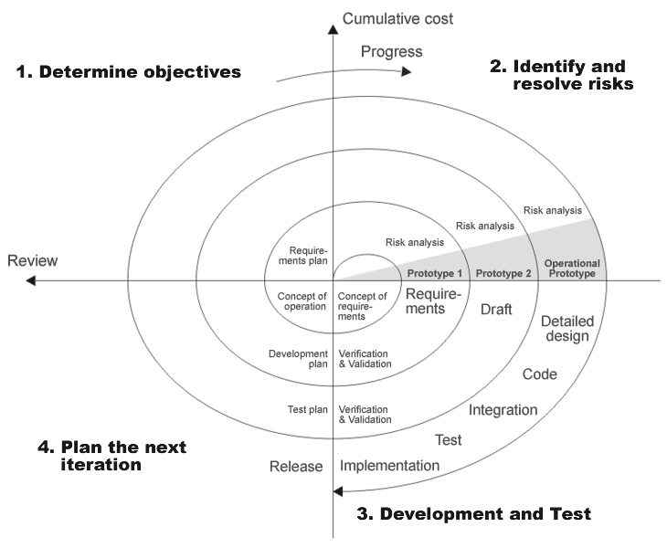
Spiral Model

Slide 12
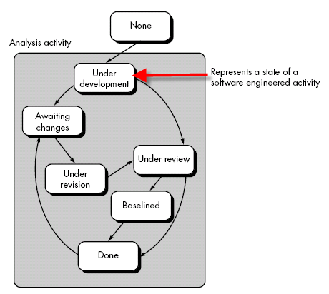
Concurrent Development Model

Slide 13
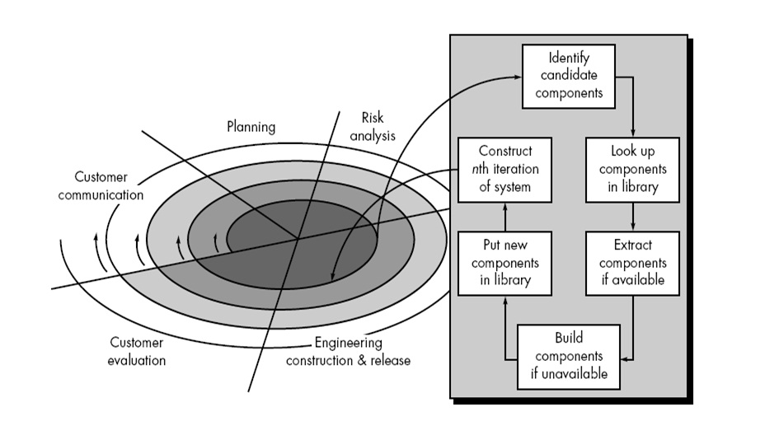
CBD Model

Slide 14
Object Oriented Approach
Software development based on modeling real world objects and then use the models to build a language independent design organized around those objects.
Promote better understanding of requirements, cleaner designs, and more maintainable systems.
Identical concept and notation throughout the software development process.

Slide 15
Object Oriented Approach
Coding - last stage in the process of development.
Good design defers implementation details until later stages of deign to preserve flexibility.
Initial stage defects have a large impact on ultimate product and on the time needed to finish.
Graphical notations helps developer to visualize a problem before beginning of implementation.

Slide 16
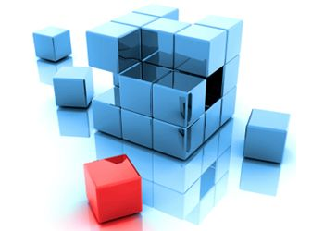
Why Modeling..?

Slide 17
Modeling
Communicate desired structure and behavior of our system
A model is a simplification of reality: Wind effect on buildings: Burj Khalifa, earthquake effect on Tehri Dam.
A hypothetical description of a complex entity or process.
A good model includes those elements that have broad effect and omits minor elements at a given level of abstraction.
A model of a system is not the system!
Modeling is used in many disciplines – architecture, aircraft building, electrical devices, microprocessors etc.

Slide 18
Why Modeling..?
Models help us to visualize a system as it is or as we want it to be.
Models permit us to specify the structure or behavior of a system.
Models give us a template that guides us in constructing a system.
Documents decisions we have made.

Slide 19
The difference between procedural and object-oriented analysis….??

Slide 20
Object-Oriented Vs Traditional analysis
Traditional procedural systems separate data and procedures, and model these separately
Object orientation –views data and functions together;
Object have identity, state and behavior
OO view more closely reflects the real world where human think in terms of things which possess both attributes and behaviors.
OO provides reuse possibility from the class hierarchy views of the system.

Slide 21
Object-orientation : Four important aspects
Identity
Classification: Instance
Polymorphism
Inheritance.

Slide 22
Object-orientation : Four important aspects
Identity
data is quantized into discrete, distinguishable entities called “objects”.
Each object has its own inherent identity.
Classifications
objects with the same data structure (attributes) and behavior (operations) are grouped into a class.
A class is an abstraction that describes properties important to an application and ignores the rest.

Slide 23
Object-orientation : Four important aspects
Inheritance
Sharing of attributes and operations among classes based on a hierarchical relationship.
A superclass has general information that subclasses refine and elaborate.
Subclasses need not repeat features of its superclass and add its own unique features.
The ability to factor out common features of several classes into a superclass can greatly reduce repetition within designs and programs and is one of the main advantages of OO technology
Polymorphism
Same operation may behave differently for different classes.

Slide 24
The Basic Principles of Object Orientation
Four basic principles:
Abstraction
Encapsulation
Modularity
Hierarchy

Slide 25
Abstraction
Denotes the essential characteristics of an object that distinguish it from all other kinds of objects.
Defines conceptual boundaries, relative to the perspective of the viewer.
Key concepts:
Concentrating only on essential characteristics
Allows complexity to be more easily managed
Abstraction is relative to the perspective of the viewer
Many different views of the same object are possible.

Slide 26
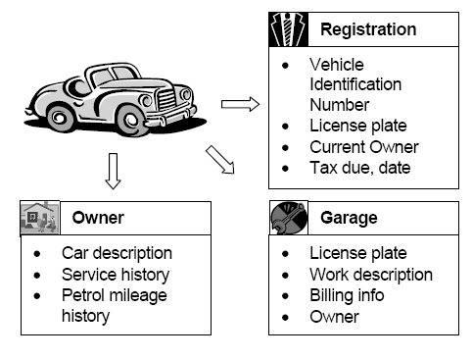
Abstraction

Slide 27

Encapsulation
Practice to hide the data in a single entity along with methods to protect information from outside.
The internal state is usually not accessible by other objects.
Key concepts:
Packaging structure and behavior together in one unit
Makes objects more independent
Objects exhibit an interface through which others can interact with it.
Hides complexity from an object’s clients.

Slide 28
Modularity
Decomposition of a system into a set of cohesive and loosely coupled modules.
Module: a collection of related classes of objects.
Key concepts:
Modules are cohesive (performing a single type of tasks)
Makes modules more reusable
Modules are loosely coupled (highly independent)
Makes modules more robust and maintainable

Slide 29
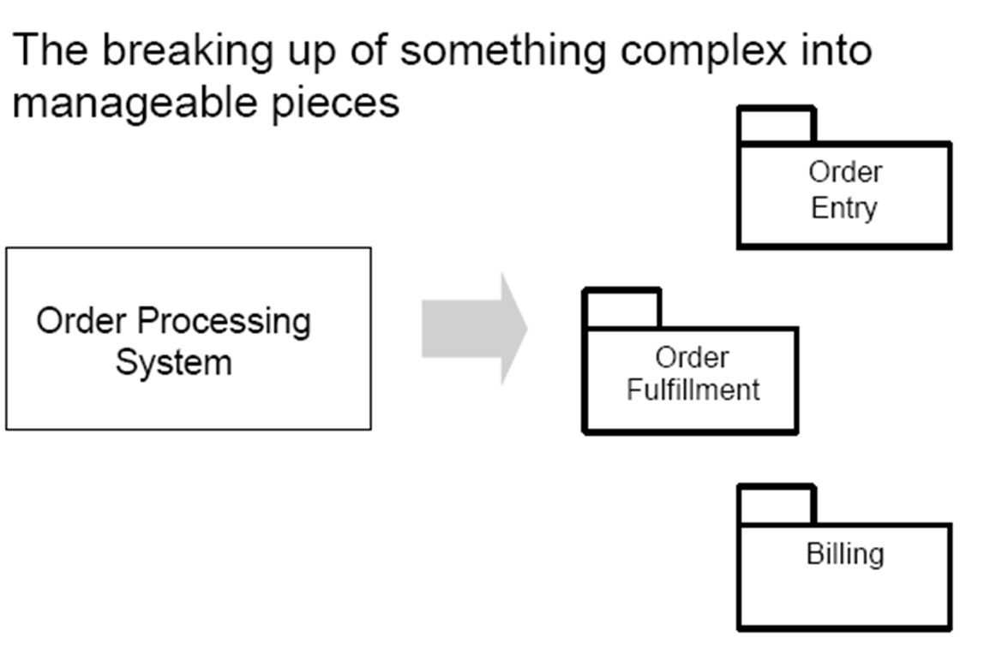
Modularity

Slide 30
Hierarchy
Hierarchy is a ranking or ordering of abstractions.
Organizing things into different levels of abstraction.
Types of hierarchies:
Class
Aggregation
Containment/composition
Specialization

Slide 31
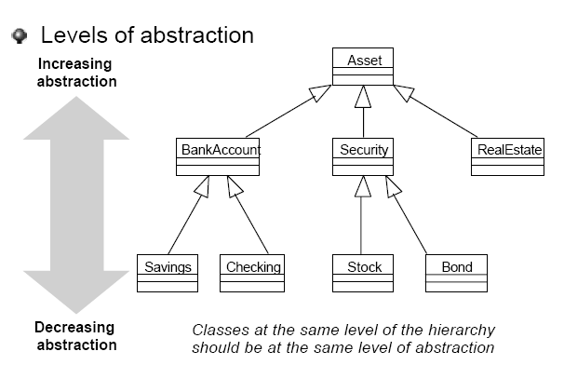
Example: Hierarchy

Slide 32
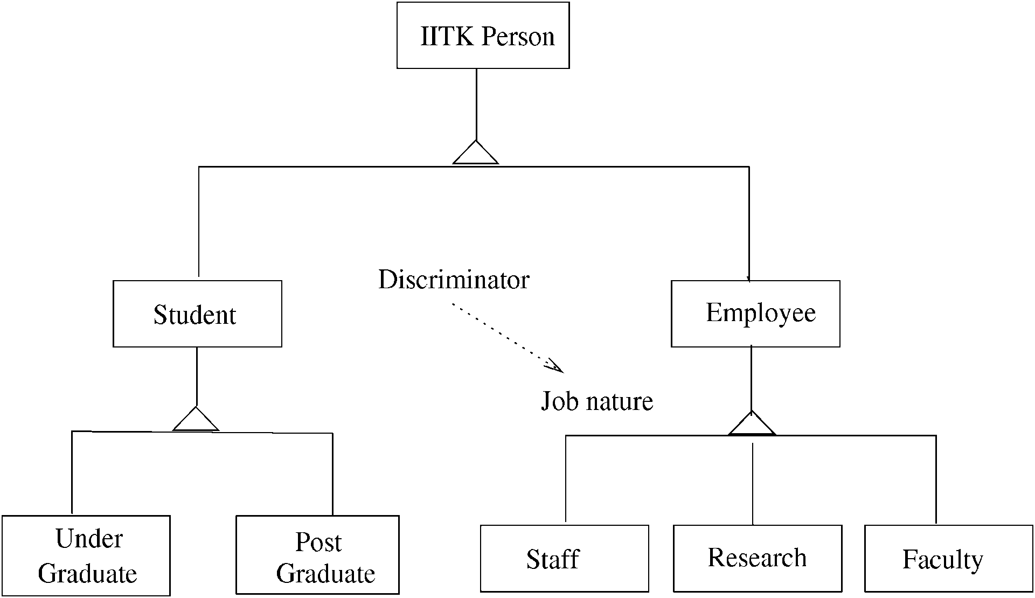
Example: Class hierarchy
UPES Person

